Slide 1
初階影像處理、嵌入式機器人視覺 及人機互動 (Introduction to Image Processing, Embedded Robot Vision and Human-Computer Interaction) Homework 2: Answer
TA:
Edward: thanhng1985@gmail.com
Charlie: p76074664@mail.ncku.edu.tw
Office Hour: 15:00~17:00, Mon. 20:00~22:00, Tue.
At CSIE 9F Robotics Lab.

Slide 2
Notice (1/2)
No Plagiarism!! If you plagiarize, you will get 0.
If TA can’t compile and run your homework. Within one week, come to our Lab (65904) and present (demo) your homework. (or your score will be zero)
Deadline: 2018/11/23(Fri) 23:59:59
No delay. If you submit homework after deadline, you will get 0.
Upload to => 140.116.154.1 -> Upload/Homework/OpenCv_Hw2
Account: opencv2018
Password: opencv2018
Format:
Filename:
Hw2_Student ID_Name_Version.rar, ex: Hw2_F71234567_林小明_v1.rar
If you want to update your file, change ver., ex: Hw2_F71234567_林小明_v2.rar
Content: whole project (including images), (Please delete the debug file)

Slide 3
Notices (2/2)
C++ (check MFC guide in ftp)
OpenCV 3.3.1 (https://opencv.org/release.html)
Visual Studio 2015 (download from http://www.cc.ncku.edu.tw/download/)
UI framework: MFC
Python (check pyqty guide om ftp)
opencv-python (3.4.3.18)
Python 3.6.5 (https://www.python.org/downloads/)
UI framework: pyqt5 (5.11.3)

Slide 4
Assignment scoring (Total: 100%)
0. GUI
1. (20%) Histogram Equalization (出題：Daniel, Oscar)
(30%) Hough Circle Transform and Histogram (出題：Helen, Phu, Carol)
2.1 Hough circle transform (10%)
2.2 Hue histogram (10%)
2.3 Back projection (10%)
3. (30%) Camera Calibration (出題：Ben, Carol , Phu)
3.1 Corner detection (10%)
3.2 Find the intrinsic matrix (10%)
3.3 Find the extrinsic matrix (5%)
3.4 Find the distortion matrix (5%)
4. (20%) Augmented Reality (出題：Daniel, Oscar)

Slide 5
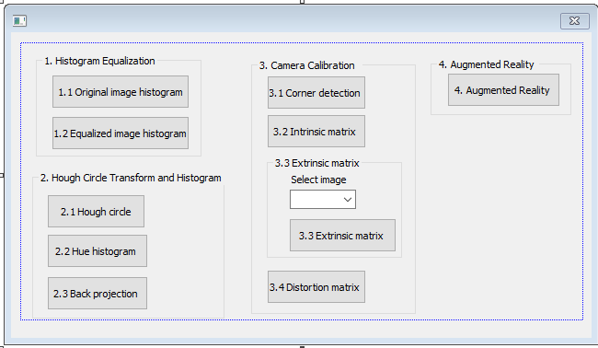
0. Homework Format
Use MFC to create GUI like following picture

Slide 6
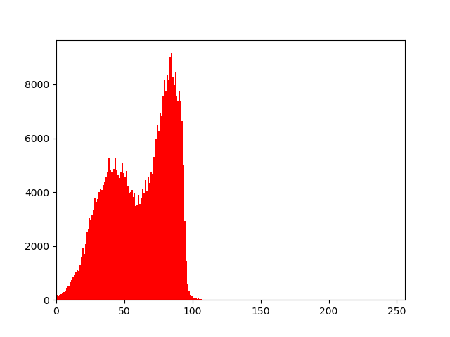
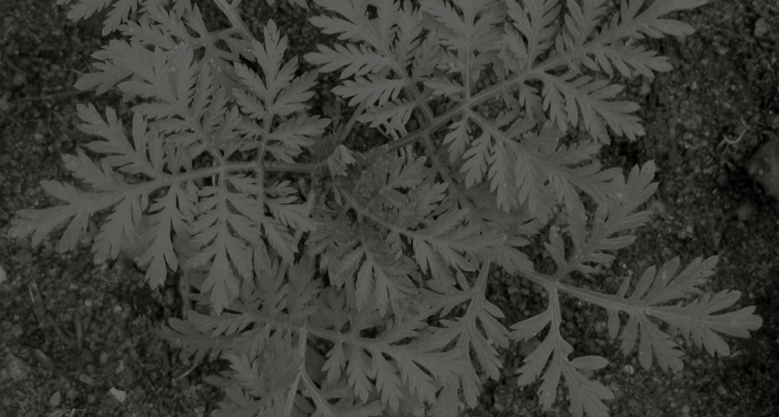
1. (20%) Histogram Equalization (出題：Daniel, Oscar)
Given: plant.jpg
Q: 1) (10%) Click the button “1.1 Original image histogram” to open two windows:
One shows the original image, plant.jpg
The other shows the original image histogram
x-axis of histogram is gray value, y-axis is total pixels of correspond gray value
Original image histogram:
Original Image:
pixel number
gray value

Slide 7
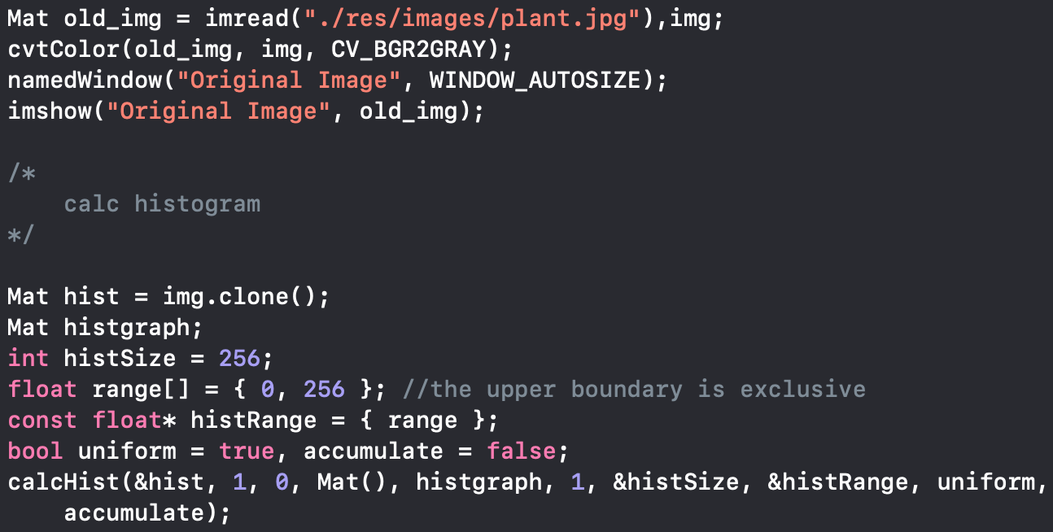
1. (20%) Histogram Equalization: Answer (出題：Michael)
A: 1) void calcHist(const Mat* images, int nimages, const int* channels, InputArray mask, OutputArray hist, int dims, const int* histSize, const float** ranges, bool uniform=true, bool accumulate=false )

Slide 8
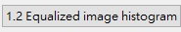
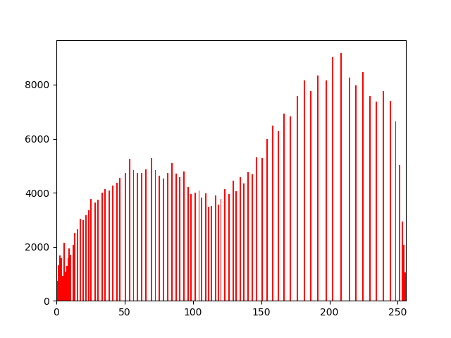
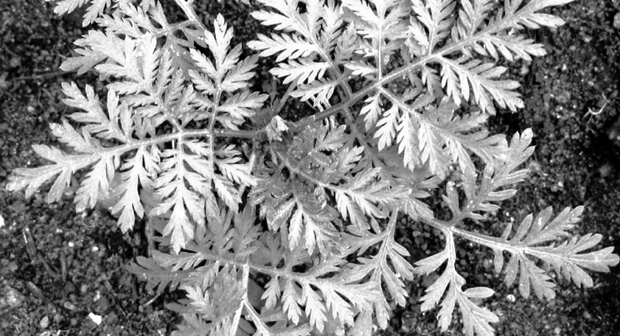
1. (20%) Histogram Equalization (出題：Daniel, Oscar)
Q: 2) (10%) Click the button “1.2 Equalized image histogram” to open two windows:
One shows the equalized image
The other shows the equalized image histogram
x-axis of histogram is gray value, y-axis is total pixels of correspond gray value
Hint : p186-190
Equalized image histogram:
Equalized image:
pixel number
gray value

Slide 9
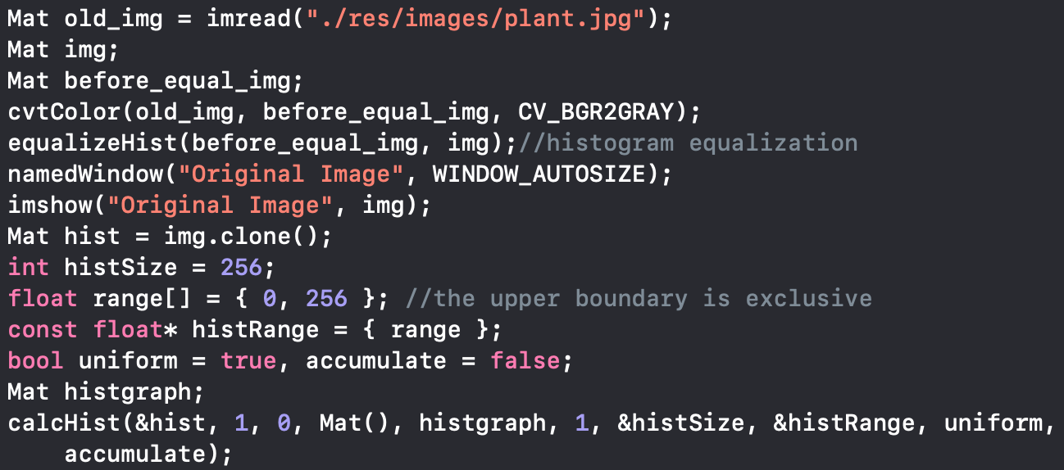
1. (20%) Histogram Equalization: Answer (出題： Michael)
A: 2) void equalizeHist(InputArray src, OutputArray dst)¶

Slide 10
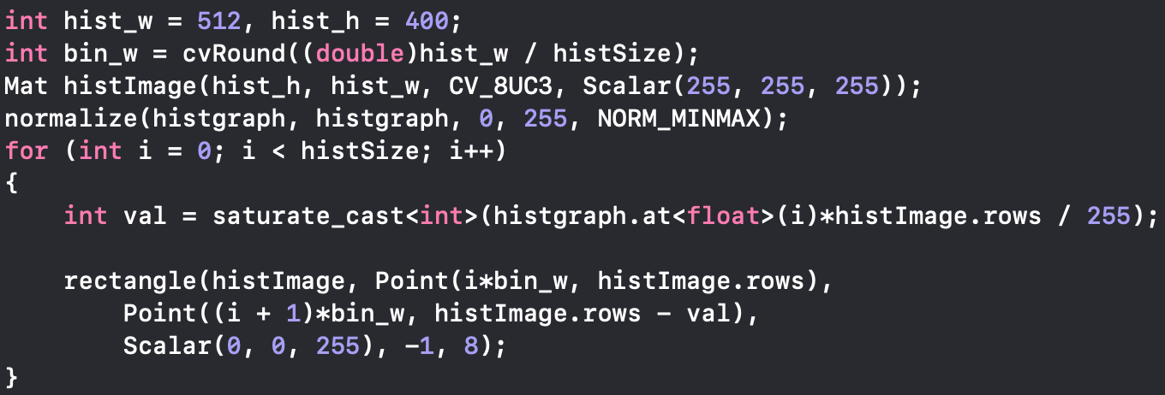
1. Draw Histogram in C++ (出題：Michael)
A: Draw histogram (1/2)
void rectangle(Mat& img, Point pt1, Point pt2, const Scalar& color, int thickness=1, int lineType=8, int shift=0)

Slide 11
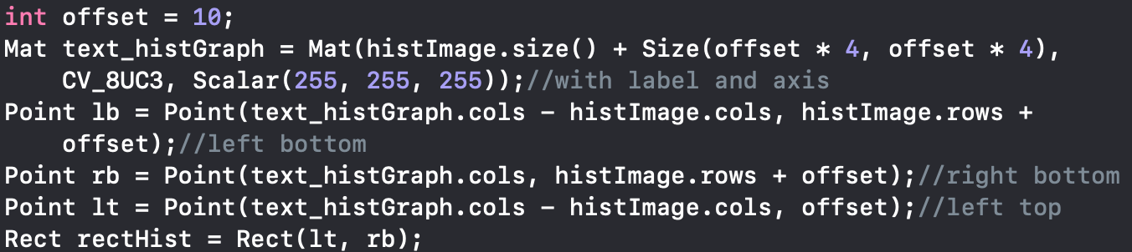
1. Draw Histogram in C++ (出題：Michael)
A: Draw histogram (2/2)

Slide 12
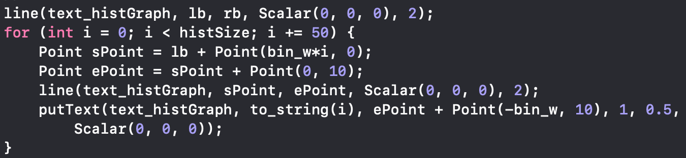
1. Draw Histogram in C++ (出題：Michael)
A: Draw axis:
Ex: x-axis

Slide 13
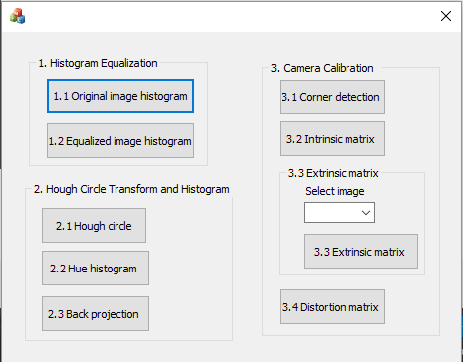
2. (30%) Hough Circle Transform and Histogram (出題：Helen, Phu, Carol)
2.1 Hough circle transform (10%)
2.2 Hue histogram (10%)
2.3 Back projection (10%)

Slide 14
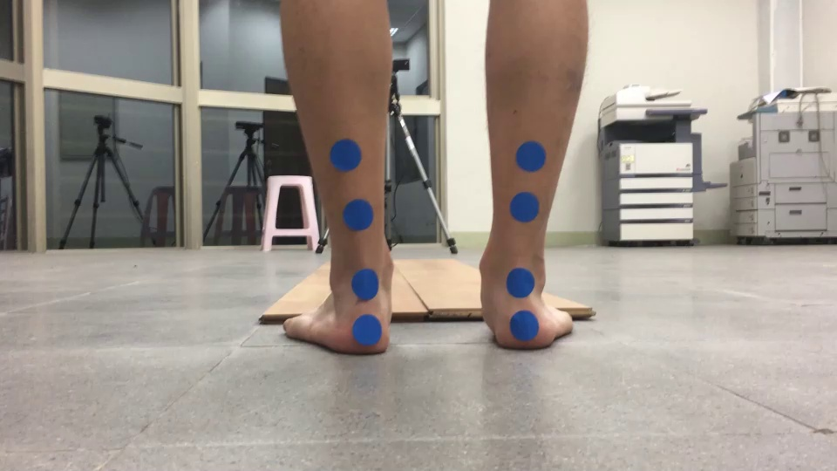
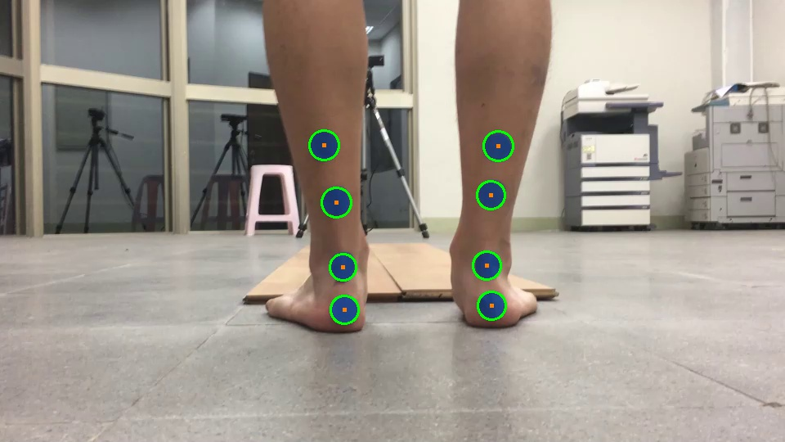
2.1. Hough circle transform (10%) (出題: Helen, Phu, Carol)
Given: q2_train.jpg image
Q. 2.1) Do Hough circle transform to detect blue dots in the q2_train.jpg then draw the boundary of the detected blue dots.
Hint:
Opencv Textbook Chapter 6, p. 159 ~ 161
HoughCircles(…)
EX:
Input image: q2_train.jpg
Output image

Slide 15
2.1. Hough circle transform (10%): Answer (Yi Yuan)
Function :
HoughCircles( image, circles, method, dp, minDist, param1, param2, minRadius, maxRadius)
image | 8-bit, single-channel, grayscale input image.
circles | Output vector of circles. Each vector is 3-element vector (x,y,radius) .
method | Detection method.
dp | Inverse ratio of the accumulator resolution to the image resolution.
minDist | Minimum distance between the centers of the detected circles.
param1 | The higher threshold of the two passed to the Canny edge detector (the lower one is twice smaller).
param2 | The accumulator threshold for the circle centers at the detection stage.
minRadius | Minimum circle radius.
maxRadius | Maximum circle radius.

Slide 16
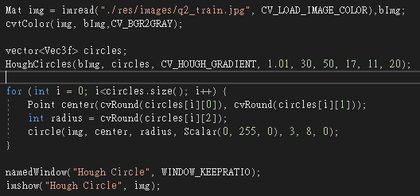
2.1. Hough circle transform (10%) (Yi Yuan)
Load an image
Convert it to grayscale
Proceed to apply Hough Circle Transform
Draw the detected circles
Display

Slide 17
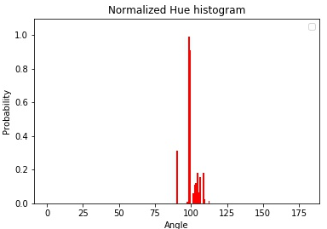
2.2. Hue Histogram (10%) (出題：Helen, Phu, Carol)
Given: q2_train.jpg image
Q. 2.2) Show the normalized Hue histogram of only all blue dots not the whole image.
Hint:
Opencv Textbook Chapter 7, p. 203
matplotlib.pyplot.hist(args)
EX: (the correct answer might not look like this)
Input image: q2_train.jpg
Output: Normalized Hue histogram

Slide 18
2.2. Hue Histogram (10%): Answer (Yi Yuan)
Function :
calcHist(images, nimages, channels, mask, hist, dims, histSize, ranges)
images | Source arrays.
nimages | Number of source images.
channels | List of the dims channels used to compute the histogram.
mask | Optional mask.
hist | Output histogram.
dims | Histogram dimensionality that must be positive and not greater than CV_MAX_DIMS (equal to 32 in OpenCV).
histSize | Array of histogram sizes in each dimension.
ranges | Array of the dims arrays of the histogram bin boundaries in each dimension.

Slide 19
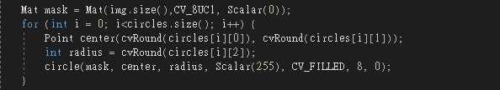
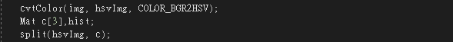
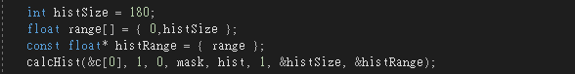
2.2. Hue Histogram (10%): Answer (Yi Yuan)
Detected blue dots
Draw the mask image
Convert image to hsv
Calculate hue histogram
Display

Slide 20
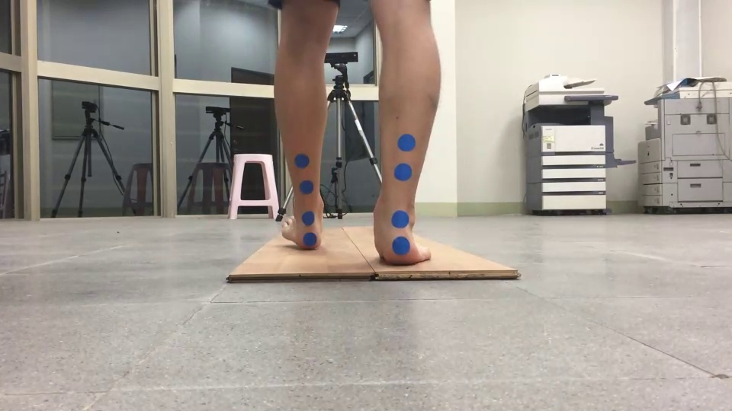
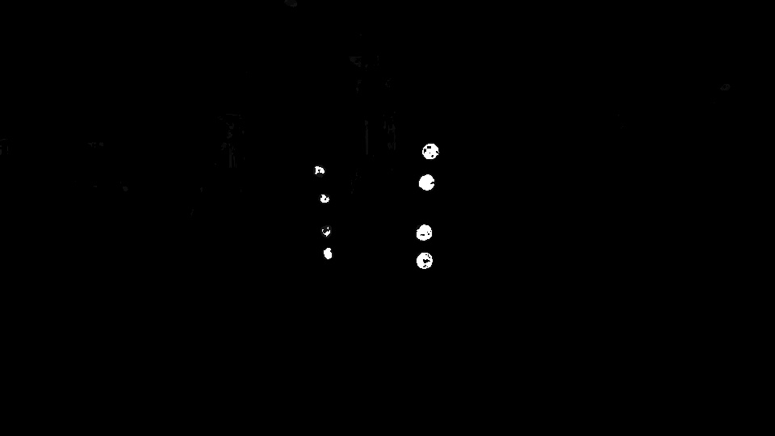
2.3. Back Projection (10%) (出題：Helen, Phu, Carol)
Given: q2_train.jpg and q2_test.jpg images
Q. 2.3) Detect blue dots in the q2_test.jpg image, then show the result as BackProjection_result.jpg image
Hint:
Opencv Textbook Chapter 7, p. 209~214
calcBackProject(args)
calcHist func.: [H_min, H_max, S_min, S_max] = [103, 121, 48, 190]
EX:
https://jacobgil.github.io/computervision/saliency-from-backproj
q2_test.jpg
BackProjection_result.jpg

Slide 21
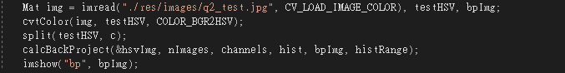
2.3. Back Projection (10%): Answer (Yi Yuan)
Function :
calcBackProject(images, nimages, channels, hist, backProject, ranges)
images | Source arrays.
nimages | Number of source images.
channels | The list of channels used to compute the back projection.
hist | Input histogram.
backProject | Output arrays.
ranges | Array of arrays of the histogram bin boundaries in each dimension.
After calculating histogram, use above function to do back projection

Slide 22
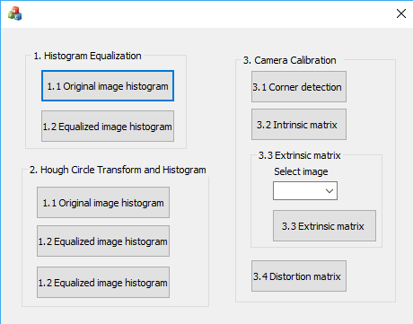
3. (30%) Camera Calibration (出題：Ben, Carol)
3.1 Corner detection (10%)
3.2 Find the intrinsic matrix (10%)
3.3 Find the extrinsic matrix (5%)
3.4 Find the distortion matrix (5%)

Slide 23
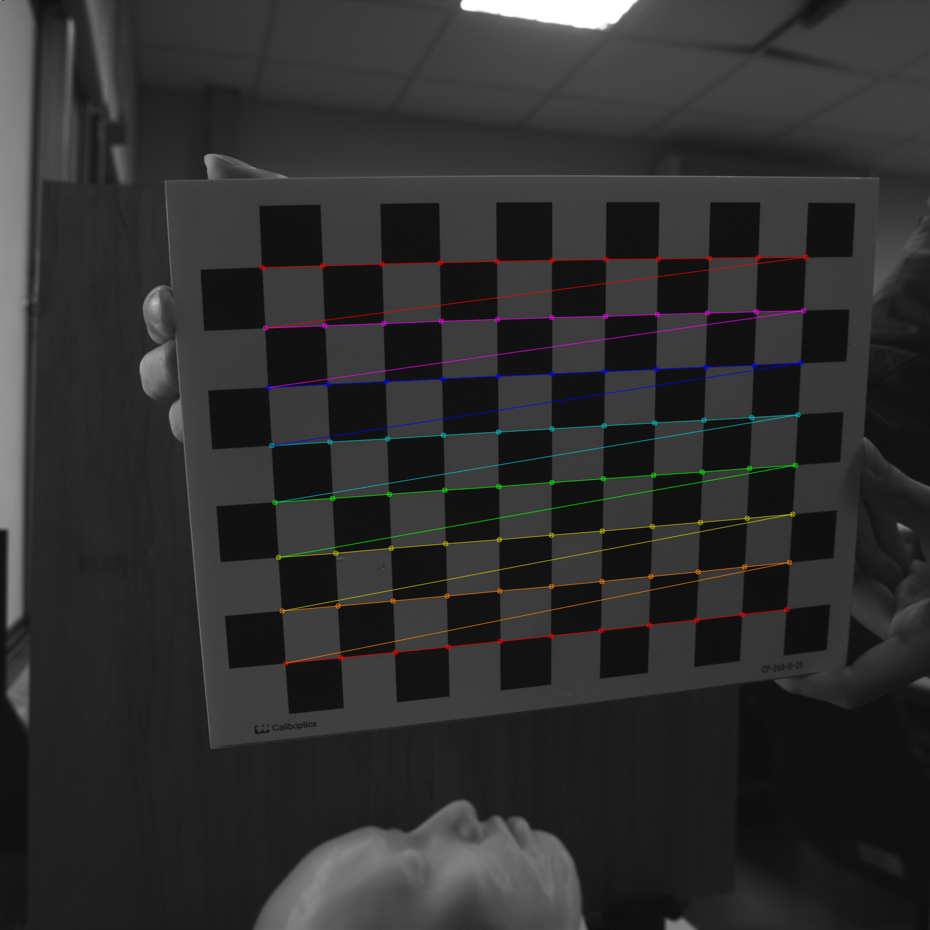
3.1 Corner detection (10%)
Given: 15 images, 1.bmp ~ 15.bmp
Q: 1) Find the corners on the chessboard for every image and draw them.
2) Click button “3.1” to show the result.
Hint :
OpenCV Textbook Chapter 11 (p. 398 ~ p. 399)
cvShowImage(…);
Ex:
23

Slide 24
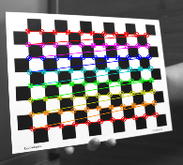
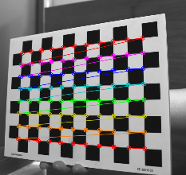
3.1 Corner detection (10%) : Answer (Chang)
Given: 15 images, 1.bmp ~ 15.bmp
Q: Find the corners on the chessboard for every image and draw them.
Answer:
// imgs: 15 images, chess_size: rows and columns of the chessboard
// corners: corners of the chessboard
findChessboardCorners( imgs[i], chess_size, corners, CALIB_CB_ADAPTIVE_THRESH | CALIB_CB_FAST_CHECK | CALIB_CB_NORMALIZE_IMAGE);
// found: Boolean result from findChessboardCorners
drawChessboardCorners( imgs[i], chess_size, corners, found);

Slide 25
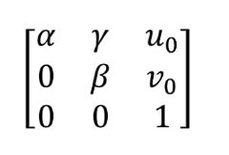
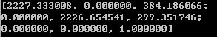
3.2 Find the intrinsic matrix (10%)
Given: 15 images, 1.bmp ~ 15.bmp
Q: 1) Find the intrinsic matrix ():
2) Click button “3.2” and then show the result on the console window.
Output format:
Hint: OpenCV Textbook Chapter 11 (P.398 ~ p.400)
(Just an example)

Slide 26
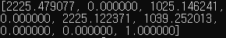
3.2 Find the intrinsic matrix (10%) : Answer (Chang)
Given: 15 images, 1.bmp ~ 15.bmp
Q: Find the intrinsic matrix ():
Answer:
// object_points: vectors of calibration pattern points
// image_points: vectors of the projections of calibration pattern points
calibrateCamera(object_points, image_points, chess_size, intrinsic, distCoeffs, rvecs, tvecs);
cout << intrinsic << endl;

Slide 27
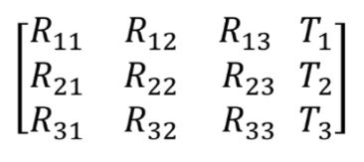
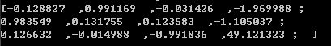
3.3 Find the extrinsic matrix (10%)
Given: intrinsic parameters, distortion coefficients, and the list of 15 images
Q: 1) Find the extrinsic matrix of the chessboard for 1 of the 15 images:
2) Click button “3.3” and then show the result on the console window.
Output format:
Hint: OpenCV Textbook Chapter 11, p.370~402
(Just an example)
(1) List of numbers: 1~15
(2) Select 1, then 1.bmp will be used, and so on

Slide 28
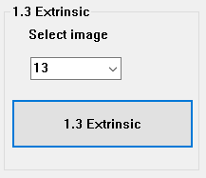
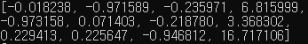
3.3 Find the extrinsic matrix (10%) : Answer (Chang)
Given: intrinsic parameters, distortion coefficients, and the list of 15 images
Q: Find the extrinsic matrix of the chessboard for 1 of the 15 images:
Answer:
// tvecs: translation vectors, rvecs: rotation vectors
Mat R, T = tvecs[num_img], RT;
Rodrigues(rvecs[num_img],R);
hconcat(R, T, RT);
cout << RT << endl;

Slide 29
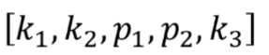
3.4 Find the distortion matrix (10%)
Given: 15 images
Q: 1) Find the distortion matrix:
2) Click button “3.4” to show the result on the console window.
Output format:
Hint:
Distortion can be founded simultaneously with intrinsic parameters
OpenCV Textbook Chapter 11 (P.398 ~ p.400)
(Just
an example)

Slide 30
3.4 Find the distortion matrix (10%): Answer (Chang)
Given: 15 images
Q: Find the distortion matrix:
Answer:
// object_points: vectors of calibration pattern points
// image_points: vectors of the projections of calibration pattern points
calibrateCamera(object_points, image_points, chess_size, intrinsic, distCoeffs, rvecs, tvecs);
cout << distCoeffs << endl;

Slide 31
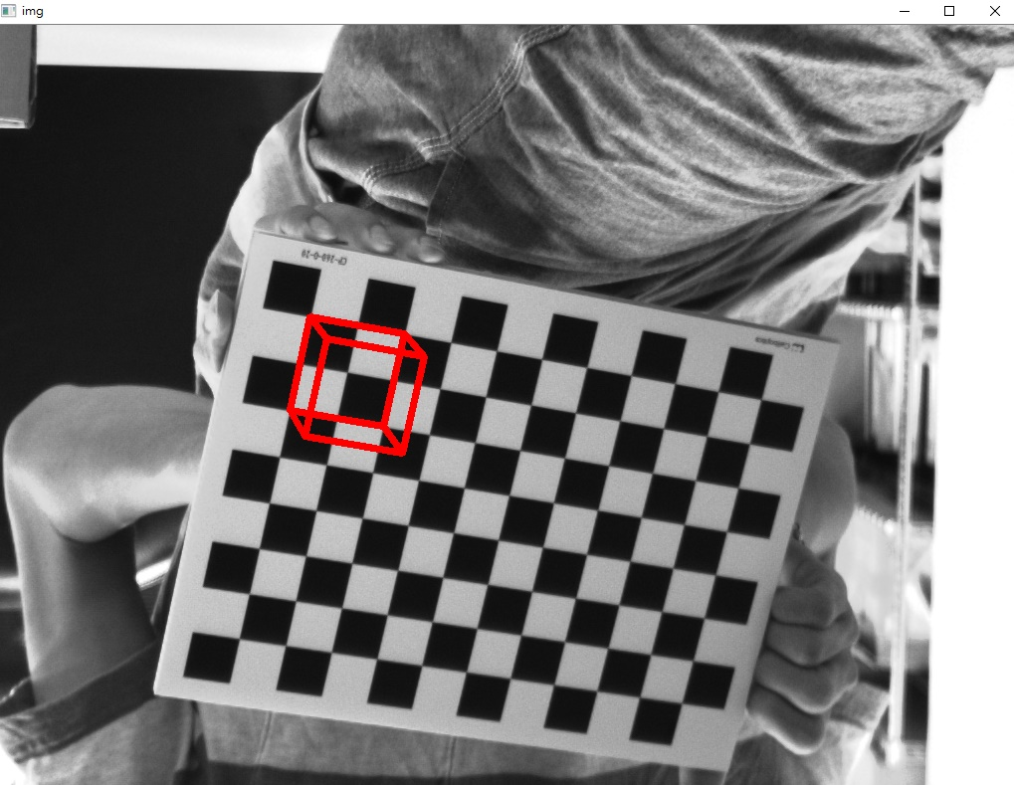
4. (20%) Augmented Reality (出題：Daniel, Oscar)
Given: intrinsic and extrinsic parameters, distortion coefficients, 5 images: 1~5.bmp
Q: 1) Draw a “Cube” on the chessboards images(1.bmp to 5.bmp) then
2) Click the button ”4. Augmented Reality” to show the Cube on the picture. Show each picture 0.5 seconds (total 5 images)
Hint : Textbook Chapter 11, p.370~402
Example:
(0,0,0)
3D Object coordinates:
Top (2, 2, -2)(2, 0, -2)(0, 0, -2) (0, 2, -2)
Corners(2, 2, 0)(2, 0, 0)(0, 0, 0)(0, 2, 0)
(0, 0, -2)
(2, 0, -2)
(0, 2, -2)
(2, 2, -2)
(0, 0, 0)
(2, 0, 0)
(0, 2, 0)
(2, 2, 0)

Slide 32
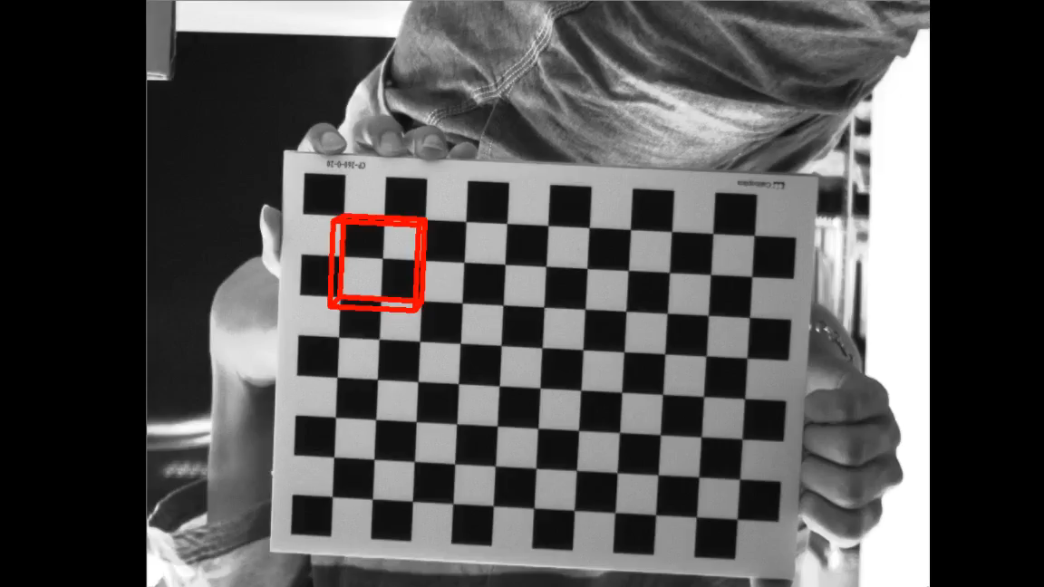
4. (20%) Augmented Reality (出題：Daniel, Oscar)
Given: intrinsic and extrinsic parameters, distortion coefficients, 5 images: 1~5.bmp
Q: 1) Draw a “Cube” on the chessboards images(1.bmp to 5.bmp) then
2) Click the button ”4. Augmented Reality” to show the Cube on the picture. Show each picture 0.5 seconds (total 5 images)
Hint : Textbook Chapter 11, p.370~402
Example:
3D Object coordinates:
Top (2, 2, -2)(2, 0, -2)(0, 0, -2) (0, 2, -2)
Corners(2, 2, 0)(2, 0, 0)(0, 0, 0)(0, 2, 0)
(0, 0, -2)
(2, 0, -2)
(0, 2, -2)
(2, 2, -2)
(0, 0, 0)
(2, 0, 0)
(0, 2, 0)
(2, 2, 0)

Slide 33
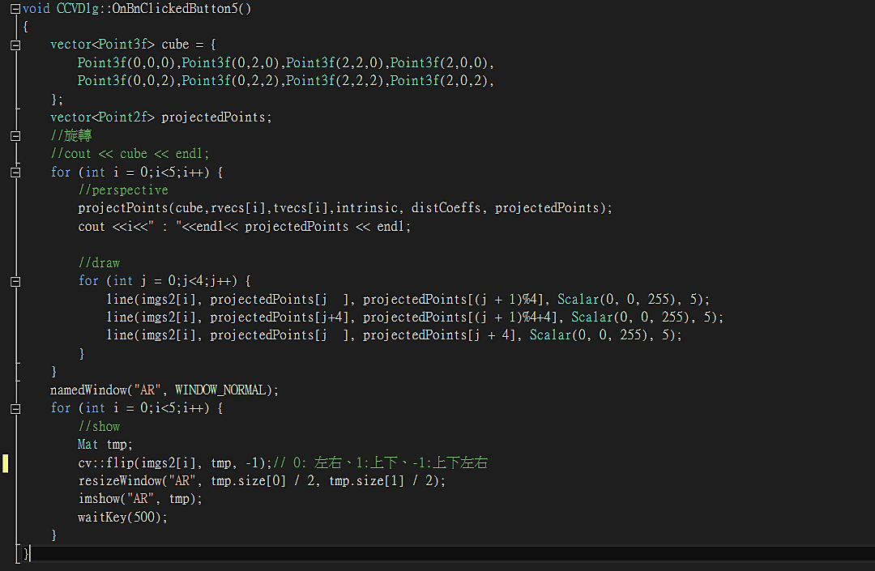
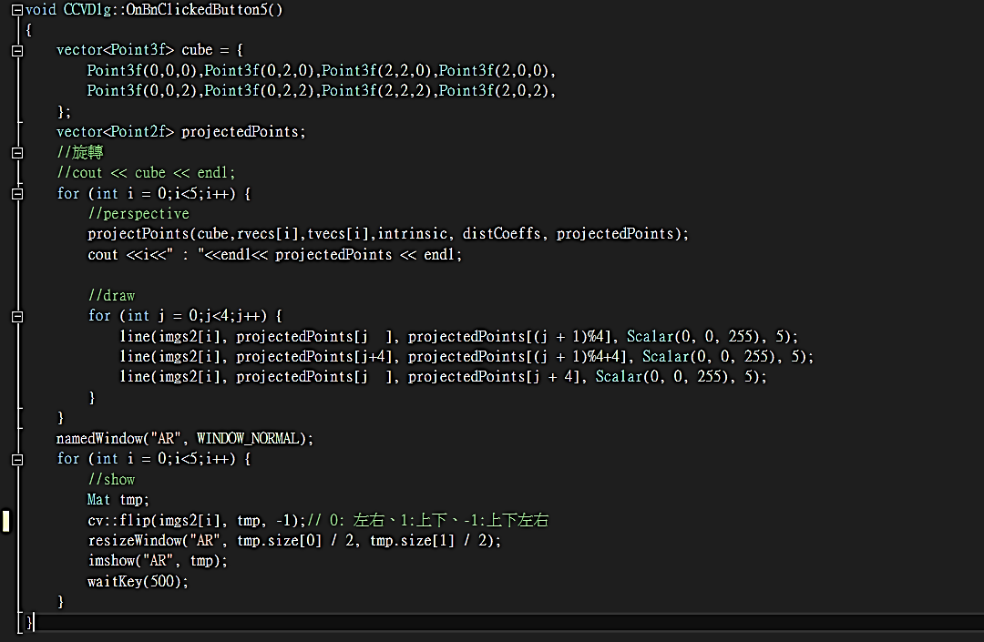
4. (20%) Augmented Reality: Answer (Charlie)
Declare 3-D points of cube
Use the intrinsic, extrinsic, distortion matrix calculated from Q1 to project cube points into 2-D point on image. Draw the cube using red lines.

